Slide 1
Recursion(2)
Shulun Zhang
225045020@link.cuhk.edu.cn

Slide 2
Overview
Brief Review
  What is recursion?
  When to use recursion?
  How to use recursion?
Some more examples
  Finding Maximum Element in an Array
  Recursive Array Reversal

Slide 3
Brief Review
What is Recursion?
Recursion is a programming technique where a method calls itself to solve smaller subproblems of the same type. A recursive method typically consists of two parts:
Base Case: The condition under which the recursion ends.
Recursive Case: The part where the method calls itself with a modified argument.

Slide 4
Brief Review
When to use recursion?
When solving a relatively large problem, you have done something on a part of it, and you find that the remaining part could be solved by the same procedure you used before.

Slide 5
Brief Review
How to use recursion?
1. A recursion algorithm must have a base case.
2. A recursion algorithm must change its state and move toward to the base case.
3. A recursion algorithm must call itself recursively.

Slide 6
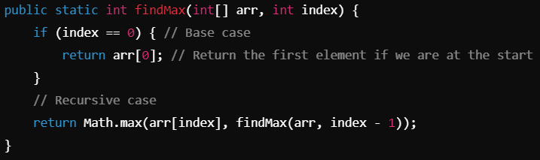
Ex.1 Finding Maximum Element in an Array
Use recursion to find the maximum element in an array.
Notes:
findMax Method: int[] arr: The array to search through, int index: The current index to evaluate.
Base Case:When index is 0, we return the first element of the array, as this is the only element left to compare.
Recursive Case: We return the maximum value between the current element (arr[index]) and the result of the recursive call to findMax with index - 1. This effectively compares each element in the array, working its way back to the start.

Slide 7
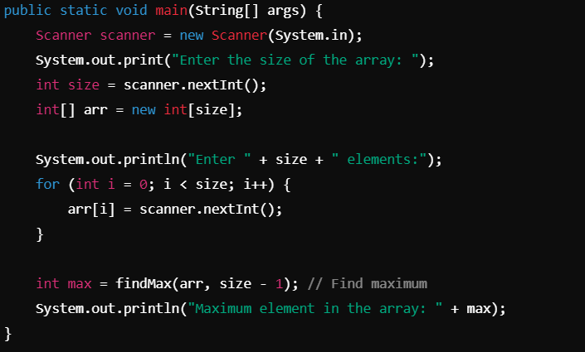
Ex.1 Finding Maximum Element in an Array
Input: 3 1 4 5
Output: 5
Notes:
main Method:
We create a Scanner object to read user input.
The user specifies the size of the array, which we read and create.
We loop to populate the array with user inputs.
Finally, we call the findMax method to find and print the maximum value in the array.

Slide 8
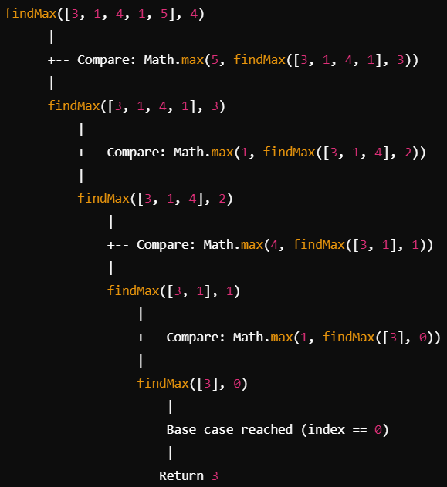
Ex.1 Finding Maximum Element in an Array

Slide 9
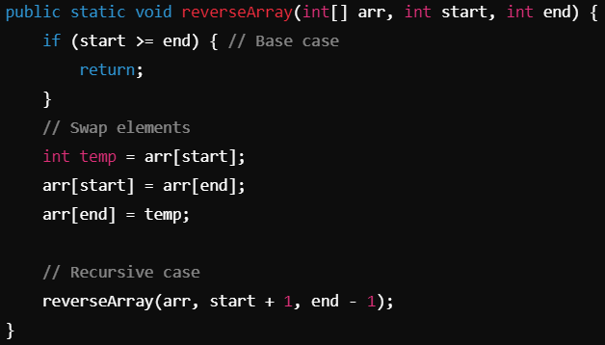
Ex.2 Recursive Array Reversal
Use recursion to reverse an array.
Notes:
Imports and Class Declaration:We import java.util.Scanner for user input and declare the class ReverseArray.
reverseArray Method: int[] arr: The array to be reversed; int start: The starting index; int end: The ending index.
Base Case: If start is greater than or equal to end, we stop recursion. This condition checks if we have crossed the midpoint of the array, meaning all elements have been swapped.
Swap Logic: We use a temporary variable temp to swap the elements at indices start and end.
Recursive Call: We call reverseArray with updated indices: start + 1 (next element) and end - 1 (previous element).

Slide 10
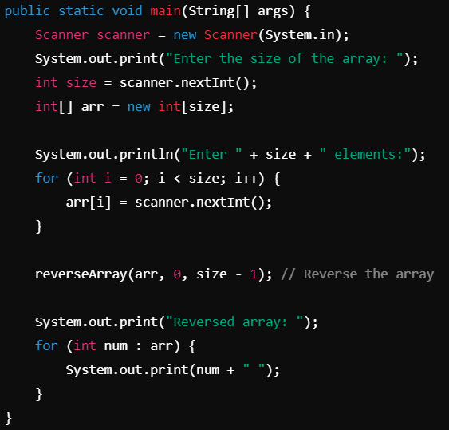
Ex.2 Recursive Array Reversal
Input: 3 1 4 5
Output: 5 4 1 3
Notes:
main Method:
We create a Scanner object to read user input.
The user specifies the size of the array, which we read and create.
We loop to populate the array with user inputs.
Finally, we call the reverseArray method to reverse the array and print the result.

Slide 11
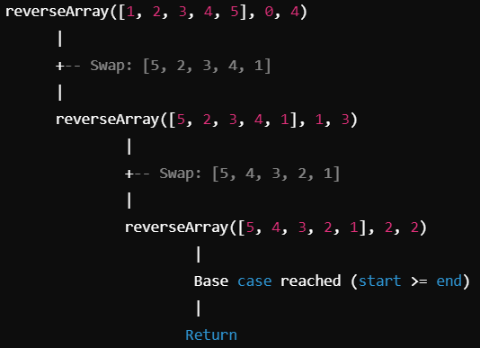
Ex.2 Recursive Array Reversal

Slide 12
Summary of Java
Java Basic: fundamental syntax and structure of Java, including data types, variables
Loops: for, while, and do-while
Arrays: int[] arr
IO (Input & Output): reading data from and writing data to various sources, such as files and the console
Functions: public static void yourFunction() {}
Recursion: a function calls itself to solve smaller instances of a problem until a base case is reached

Slide 13
Next week, we will start to talk about python.
Q&A

